Slide 1
CS-584 - Machine Learning
Advanced ML Models for prediction anemia in children.
Guidance: Prof. Yan Yan Team Members: Rahul Mansharamani (A20553261)
Kajal Dalai (A20528697)
Vedant Chaubey (A20553928)

Slide 2
Topics
Introduction
Previous Work
Proposed Work
Exploratory Data Analysis Results
Pre-Processing Results
Pre-Processing Visualization
Selected Models
Model Performance With Default Parameters
Hyperparameter Tuning and Dimensionality Reduction
Model Performance With Hyperparameter Tuning and Dimensionality Reduction
Models Comparison
Future Work/Improvements
Conclusion

Slide 3
Introduction
Problem Statement: Childhood anemia is a critical public health concern, particularly in developing nations like Bangladesh, affecting cognitive development and disease resilience.
Traditional methods for anemia prediction are limited.
We propose leveraging advanced machine learning (ML) models to enhance prediction accuracy.

Slide 4
Previous Work
- Overview of previous studies utilizing ML algorithms for childhood anemia prediction.
- Mention of algorithms used: Linear Discriminant Analysis, Classification and Regression Trees, k-Nearest Neighbors, Support Vector Machines, Random Forest, Logistic Regression.
- Highlight the study achieving the best accuracy with Random Forest.

Slide 5
Proposed Work
- Extension of previous work with advanced ML models.
- Incorporation of additional predictive features like dietary patterns, genetics, and environment.
- Aim to improve prediction accuracy and aid in more effective intervention strategies.

Slide 6
Dataset
The dataset consists of 33,924 records with 16 features before data cleaning
The dataset is supervised learning, since, labels are given
The task here is based on Multivariate classification and the target column is Anemia level.1
Dataset Name - Factors Affecting Children Anemia Level
Dataset Source - https://www.kaggle.com/datasets/adeolaadesina/factors-affecting-children-anemia-level/data

Slide 7
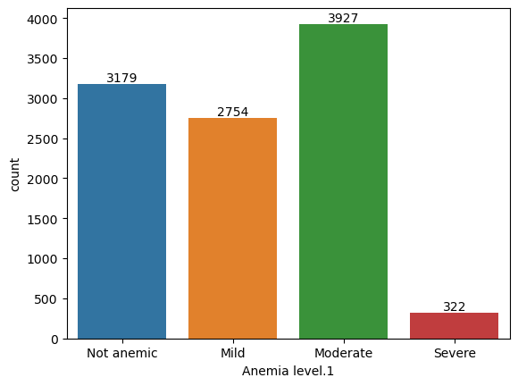
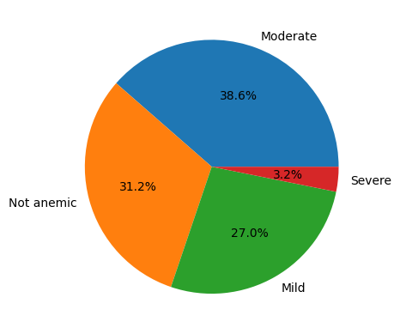
Dataset - Anemia Type Distribution

Slide 8
Data Preprocessing
One Hot Encoding
Conversion of categorical data into a binary matrix format. In this encoding scheme, each category or label is represented as a binary vector with all zeros except for the index that corresponds to the category, which is marked with a 1.
NaN Values
NaN (Not a Number) values represent missing or undefined data in a dataset. Dealing with NaN values is a crucial step here, as many machine learning algorithms cannot handle missing data

Slide 9
Selected Models
We introduced four models and also present comparisons between these models. Some of the models and techniques takes substantial computational power. We selected only those machine learning models that reduces the training time and give faster predictions.
Below models are selected to train the dataset.
Logistic Regression
Naive Bayes
Decision Tree
Random Forest Classifier

Slide 10
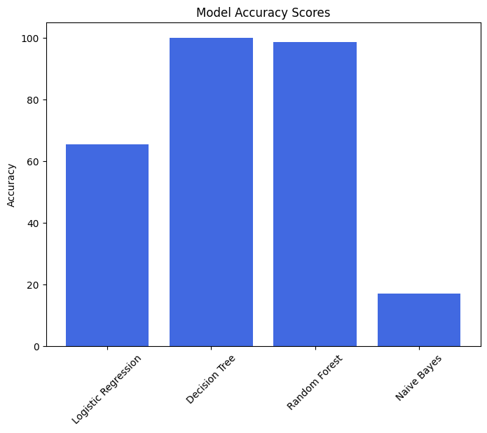
Model Performance With Default Parameters

Slide 11
Model Performance (Continue…)
Model | Precision | Recall | F1 | Accuracy | Confusion Matrix
Logistic Regression | 0.63 | 0.65 | 0.64 | 65.44% | [[153 142 225 0] [ 97 613 34 12] [105 30 467 0] [ 0 24 0 31]]
Decision Tree | 1.00 | 1.00 | 1.00 | 100% | [[520 0 0 0] [ 0 756 0 0] [ 0 0 602 0] [ 0 0 0 55]]
Naive Bayes | 0.61 | 0.17 | 0.22 | 17.12% | [[100 6 5 409] [ 26 8 20 702] [ 28 5 170 399] [ 0 0 2 53]]
Random Forest | 0.99 | 0.99 | 0.98 | 98.76% | [[519 1 0 0] [ 0 756 0 0] [ 0 0 602 0] [ 0 25 0 30]]

Slide 12
Hyperparameter Tuning and Dimensionality Reduction
We investigated the effectiveness of PCA and UMAP techniques for dimensionality reduction, specifically setting n_components=2 for UMAP to obtain a two-dimensional representation of the data. Additionally, we utilized PCA with n_components=0.95, ensuring that it retained principal components sufficient to preserve 95% of the variance in the original data. To enhance our model's performance further, we employed GridSearchCV for hyperparameter tuning, which led to notable improvements in accuracy.

Slide 13
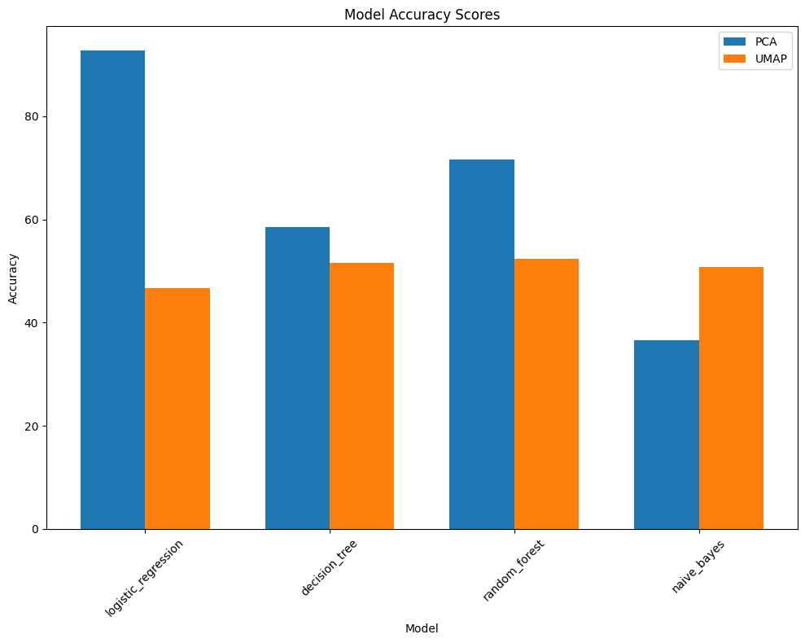
Model Performance with Hyperparameter Tuning and Dimensionality Reduction

Slide 14
Model Performance with PCA
Model | Precision | Recall | F1 | Accuracy | Best Parameter
Logistic Regression | 0.93 | 0.93 | 0.93 | 92.81% | logisticregression__C: 10
Decision Tree | 0.59 | 0.59 | 0.59 | 58.67% | max_depth: 7
Naive Bayes | 0.38 | 0.37 | 0.30 | 36.63% | NA
Random Forest | 0.71 | 0.71 | 0.70 | 71.44% | n_estimators: 300

Slide 15
Model Performance with UMAP
Model | Precision | Recall | F1 | Accuracy | Best Parameter
Logistic Regression | 0.43 | 0.46 | 0.43 | 46.20% | logisticregression__C: 10
Decision Tree | 0.55 | 0.51 | 0.52 | 50.65% | min_dist: 0.5, n_neighbors: 15
Naive Bayes | 0.48 | 0.50 | 0.49 | 49.72% | NA
Random Forest | 0.56 | 0.52 | 0.53 | 51.84% | min_dist: 0.3, n_neighbors: 15

Slide 16
Future Work/Improvements
Explore Additional Models
Comprehensive Performance Assessment
Refine Feature Engineering
Enhance Ensemble Learning
Optimize Hyperparameters
Validate Model Performance
Incorporate Domain Expertise
Document and Report Findings

Slide 17
Conclusion
Our project has advanced the use of machine learning to address childhood anemia in developing countries.
Promising results have been achieved with models like Decision Tree and Random Forest.
Further refinement is needed to enhance model accuracy and effectiveness.
By incorporating domain expertise and refining our approach, we aim to improve public health interventions.
Thank you for your support—we're committed to continuing this important work.

Slide 18
Thank You

